Slide 1


鋼構接頭耐震行為和混凝土結構於火害下之熱傳分析
FEA NX STANDARD TUTORIAL SERIES
註:範例相關參數使用假設條件。
support@midasuser.com.tw

Slide 2
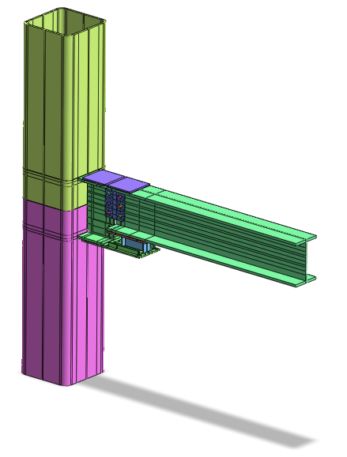

CASE 1
NTUST STEEL STRUCTURE JOINT ANALYSIS
Case Analysis : T10K16-I
Reference: 應用於貫穿式與內藏式橫隔板柱方管柱之 高復原力鋼結構用組裝式梁柱接頭之 耐震行為與試驗研究

Slide 3
HIGHLIGHTS
Basic Functions / GUI
Procedures

Slide 4
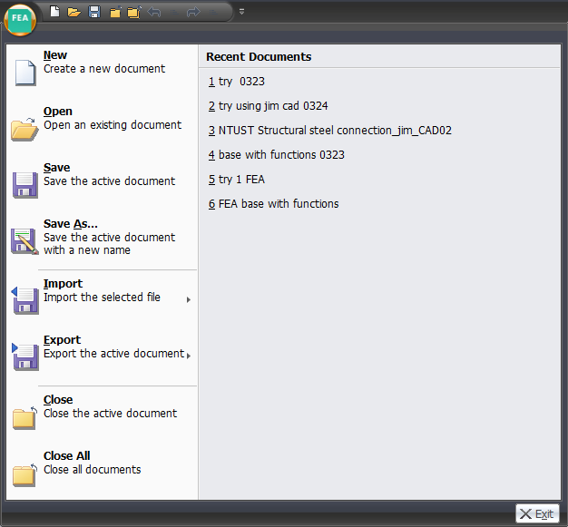
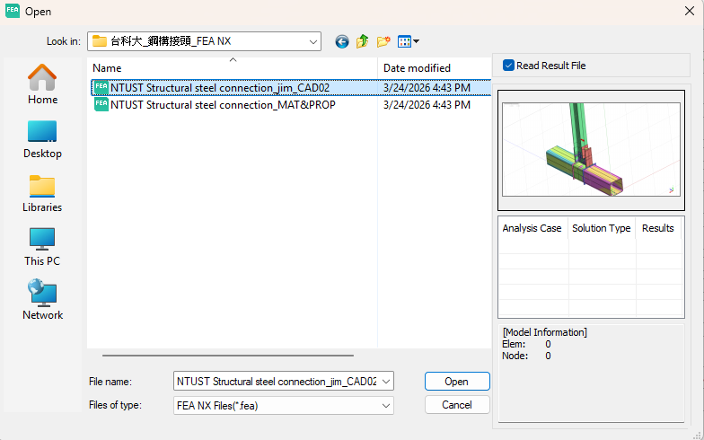
DRAWING (IMPORT)

Slide 5
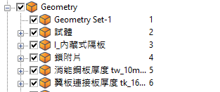
MODEL
Work Tree

Slide 6
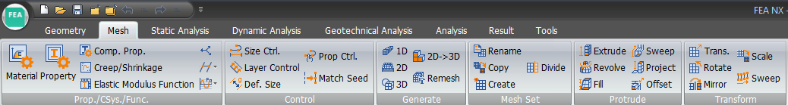
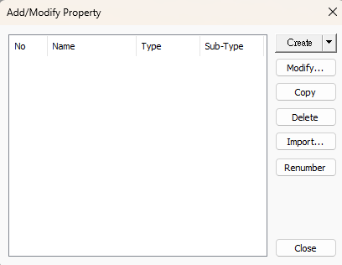
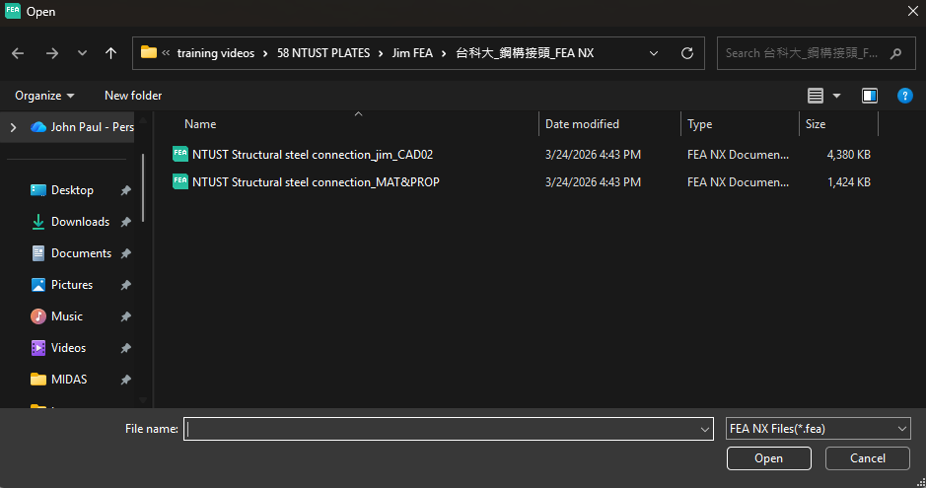
MATERIAL AND PROPERTY IMPORT

Slide 7
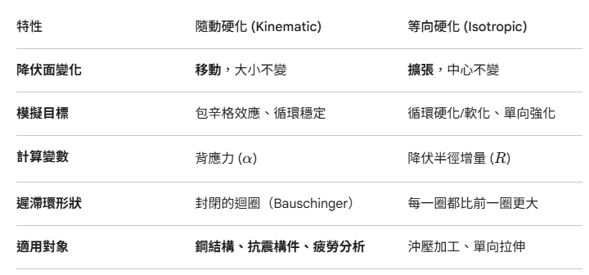
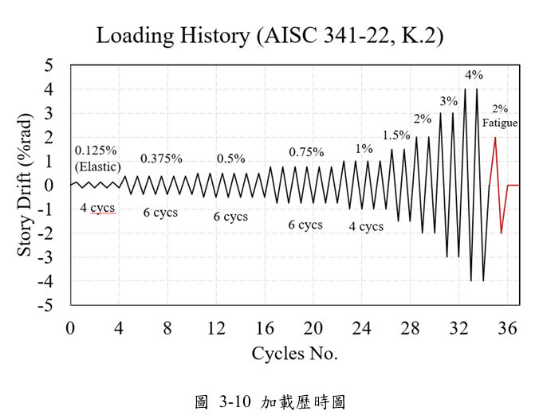
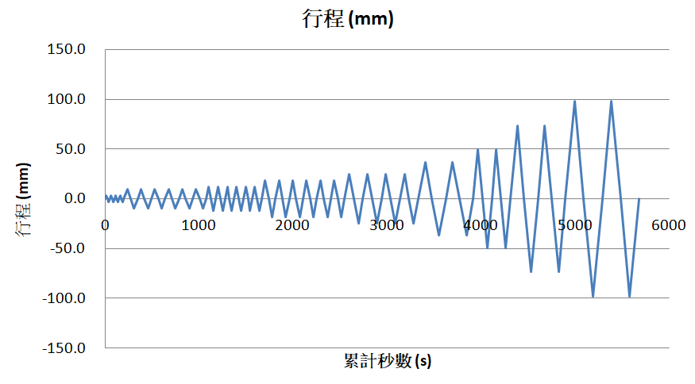
混合硬化模型 Combined Isotropic and Kinematic Hardening
Laboratory Test
NFX Simulation (Time domain)
只考慮Kinematic Hardening

Slide 8
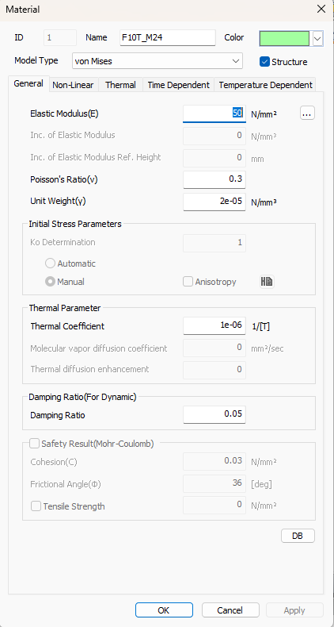
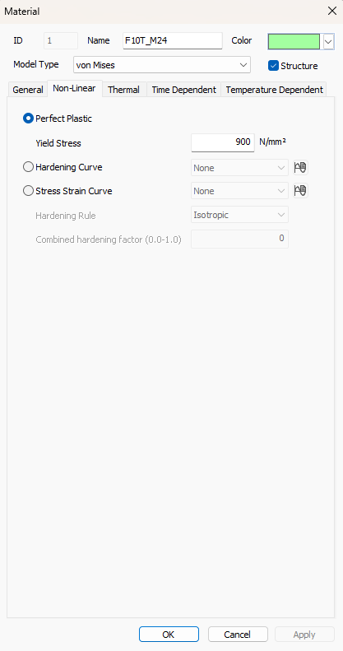
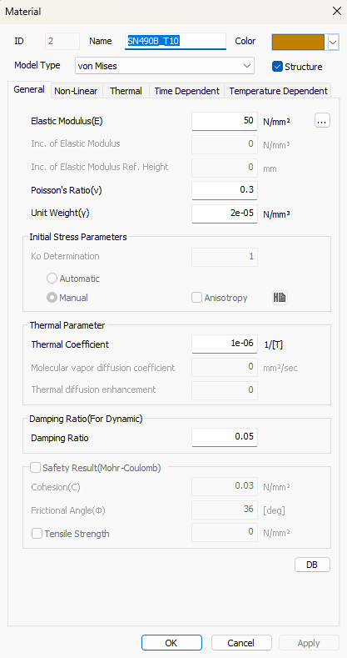
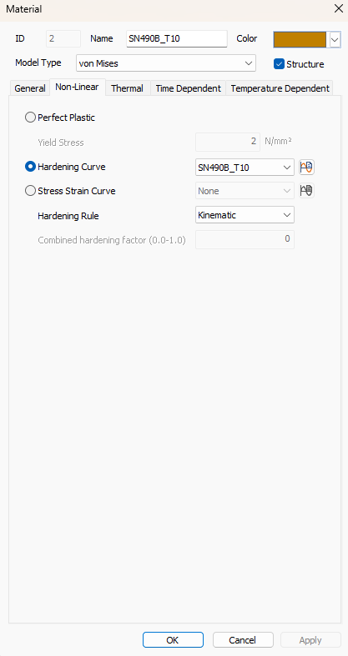
MATERIAL

Slide 9
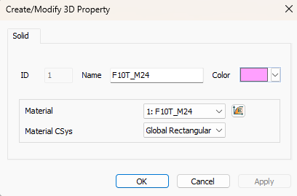
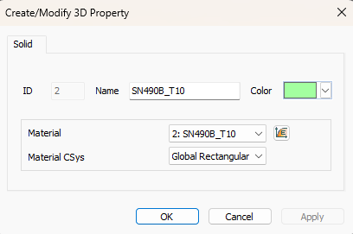
PROPERTY

Slide 10
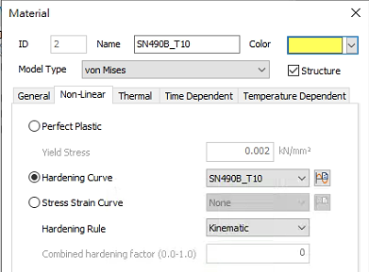
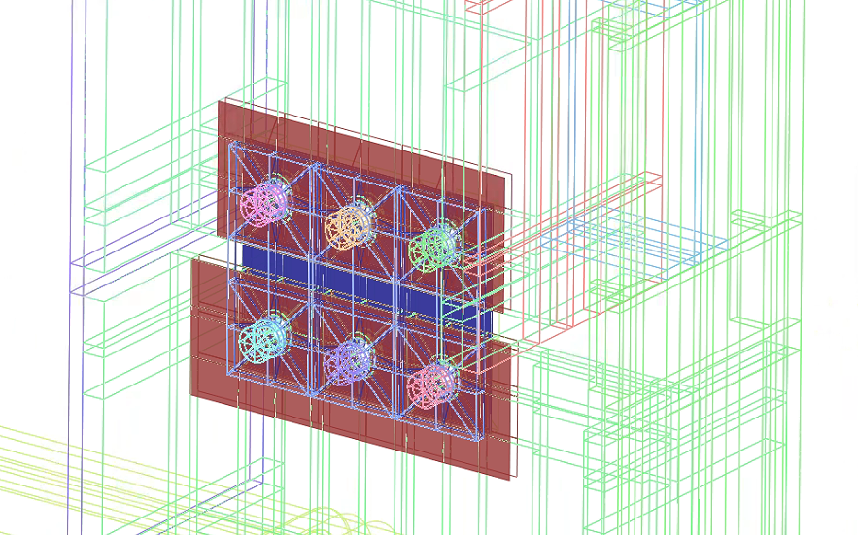
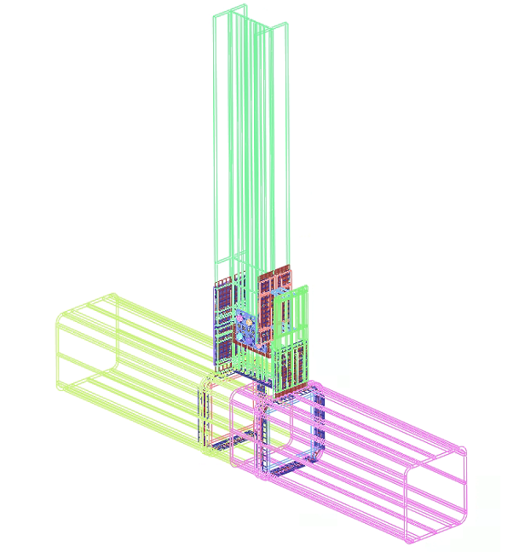
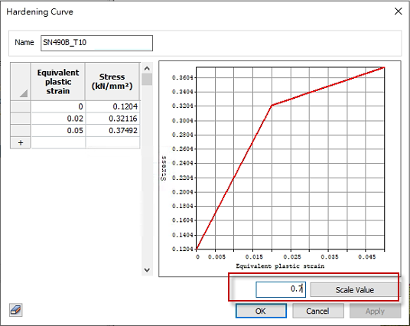
T10K16-I Way1-1
NON-LINEAR PARAMETER (HARDENING)
General Contact
Weld Contact
The entire feature surface
0.7 scale

Slide 11
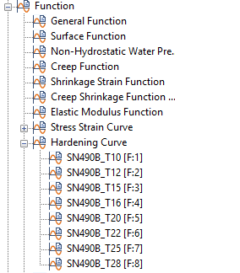
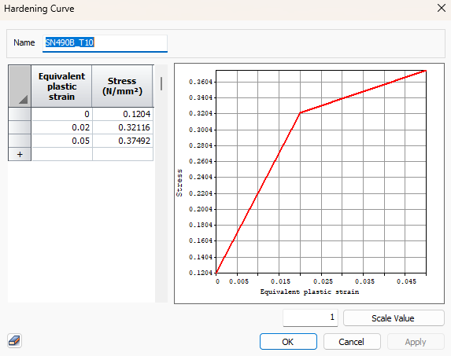
DEFINING FUNCTIONS
Scale to 70%
Notes:
Then check materials to “kinematic”

Slide 12
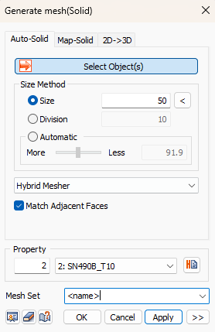
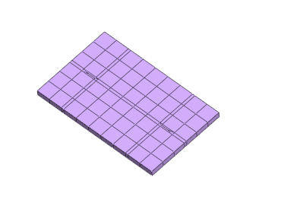
MESHING
Repeat to all parts
Notes:
Then check materials to “kinematic”

Slide 13
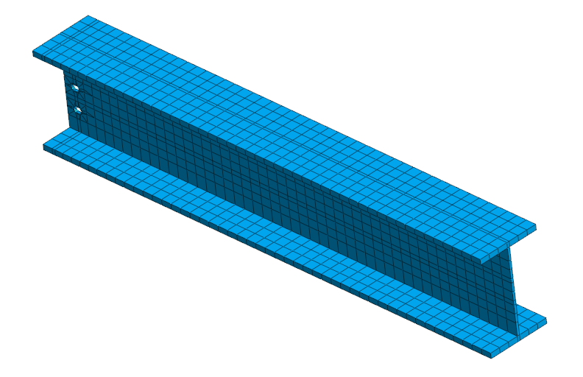
MESHING
Notes:
Then check materials to “kinematic”

Slide 14
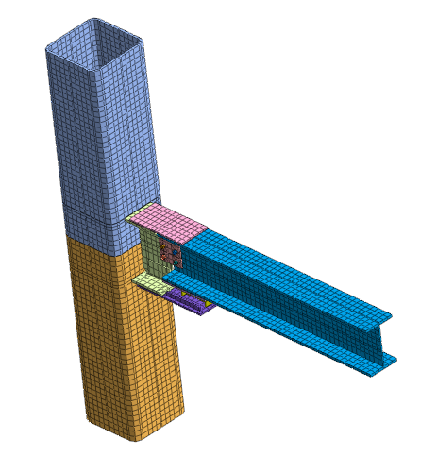
MESHING
Full model meshed
Notes:
Then check materials to “kinematic”

Slide 15
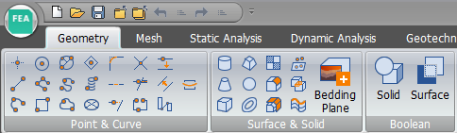
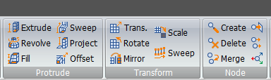
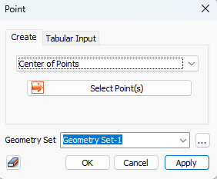
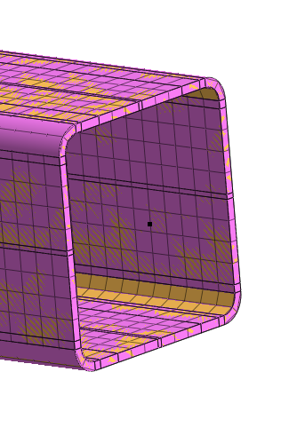
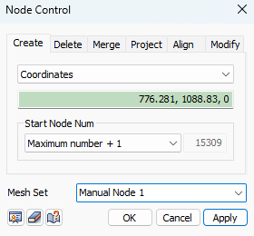
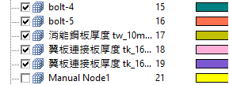
RIGID LINK
Notes:
Then check materials to “kinematic”

Slide 16
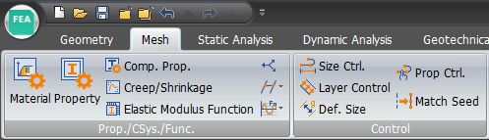
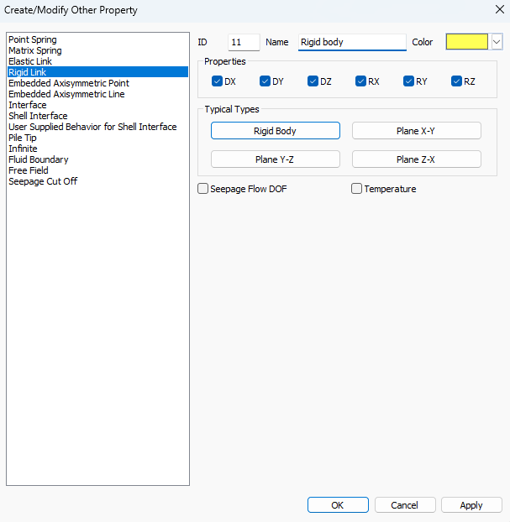
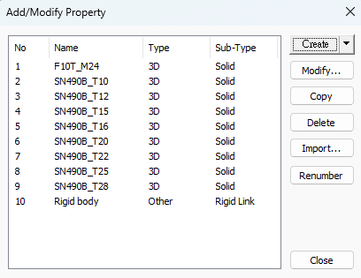

RIGID LINK
Notes:
Then check materials to “kinematic”

Slide 17
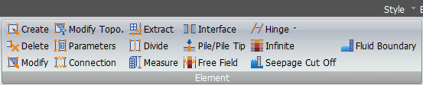
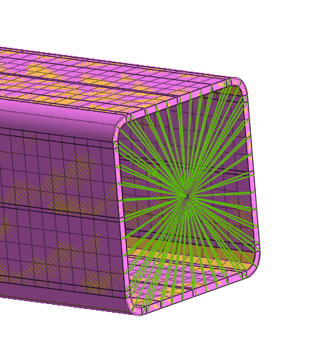
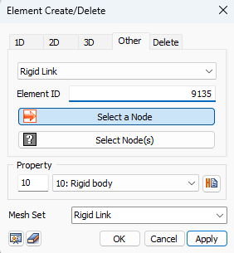
RIGID LINK
Notes:
Then check materials to “kinematic”

Slide 18
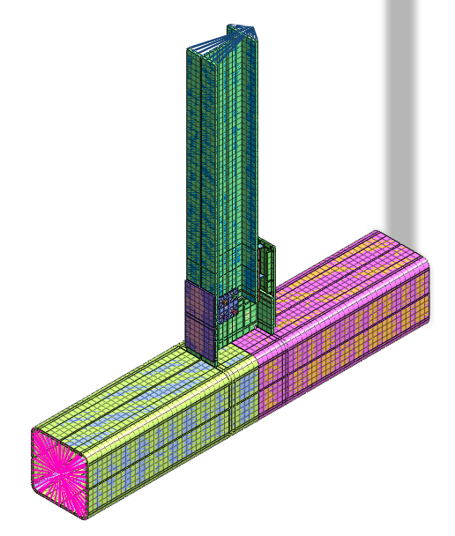
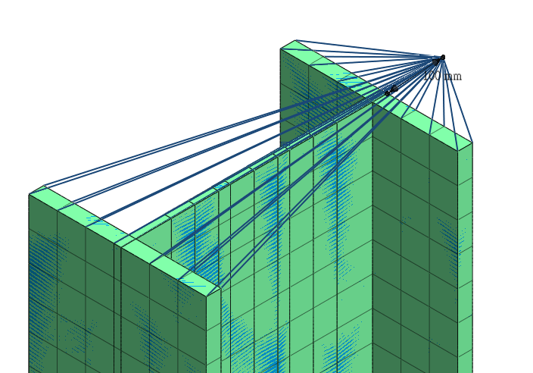
RIGID LINK
Notes:
Then check materials to “kinematic”

Slide 19
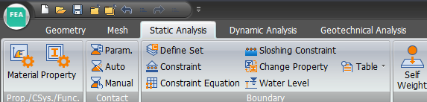
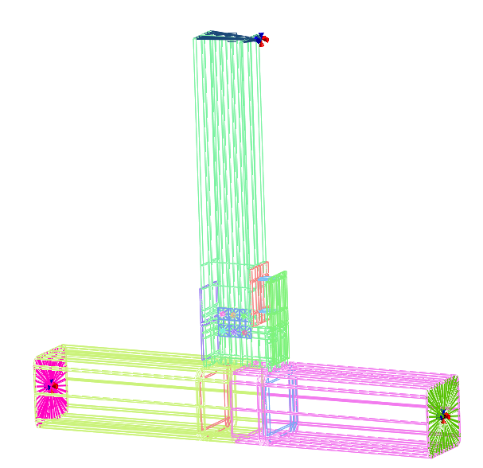
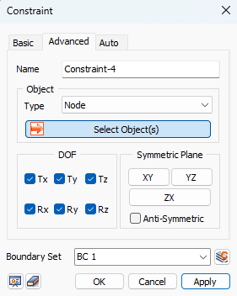

BOUNDARY CONDITIONS
Notes:
Then check materials to “kinematic”

Slide 20
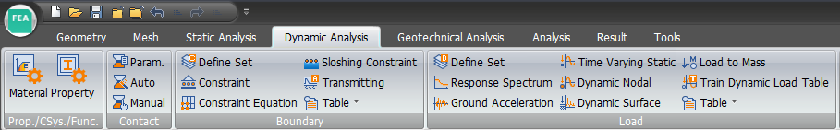
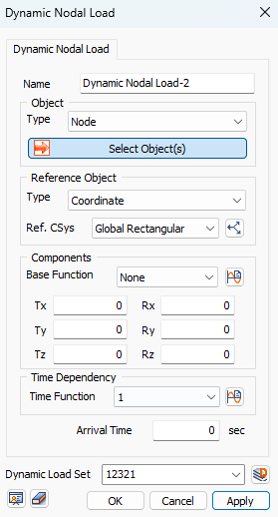
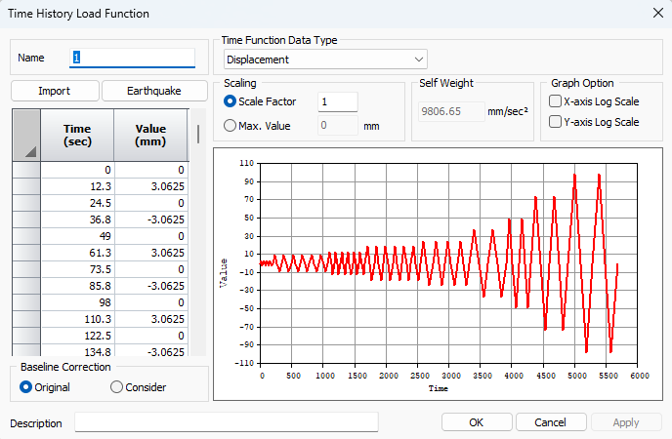
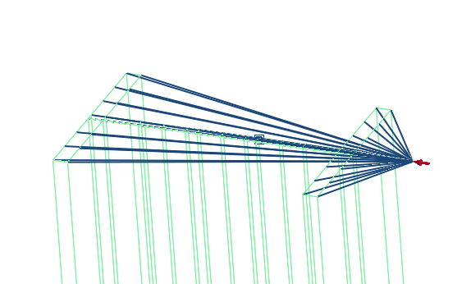
TIME DEPENDENT LOADING
Data from Excel
Notes:
Then check materials to “kinematic”

Slide 21
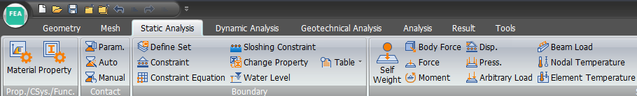
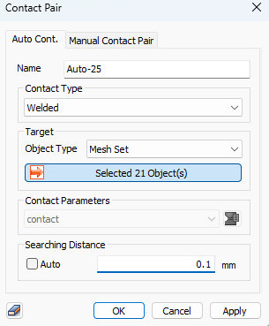
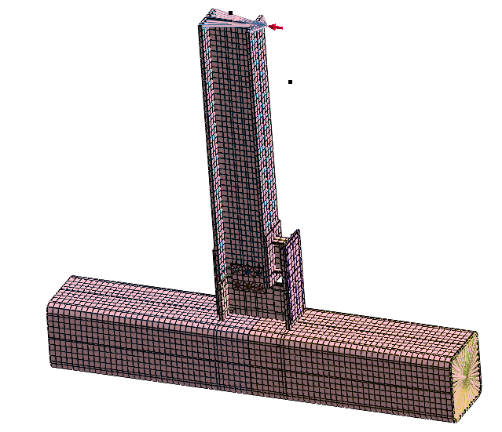

CONTACT
Notes:
Then check materials to “kinematic”

Slide 22






CONTACT
For all the connection plates
Notes:
Then check materials to “kinematic”

Slide 23



ANALYSIS (TIME STEP)
Notes:
Then check materials to “kinematic”

Slide 24

ANALYSIS (CONTROL)
Notes:
Then check materials to “kinematic”

Slide 25

ANALYSIS (CONTROL)
Notes:
Then check materials to “kinematic”

Slide 26



RESULTS (DISPLACEMENT)
Notes:
Then check materials to “kinematic”

Slide 27



RESULTS (SOLID S-XX)
Notes:
Then check materials to “kinematic”

Slide 28



RESULTS (REACTION Tz)
Notes:
Then check materials to “kinematic”

Slide 29



RESULTS (EXTRACT)
Notes:
Then check materials to “kinematic”

Slide 30


LABORATORY TEST VS FEA NX SIMULATION
總計算時間:3658.24 (sec)

Slide 31


RESULTS (EXTRACT)
Notes:
Then check materials to “kinematic”

Slide 32

FEA NX Standard Tutorial Series Time-dependent Creep and Heat of Hydration Analysis
Fire Safety Simulation for Subway Station Box Structures
台灣邁達斯
沈約翰
support@midasuser.com.tw
註:範例相關參數使用假設條件。

Slide 33

CASE 2
Time-dependent Creep And Heat Of Hydration Analysis Fire Safety Simulation For Subway Station Box Structures

Slide 34


CONCRETE HIGH-TEMPERATURE PROPERTIES | ELASTIC MODULUS
Elastic Modulus
Li and Purkiss (2005) proposed the ratio of the elastic modulus of concrete at elevated temperatures E(T) to the elastic modulus at ambient temperature E₀, as shown in the figure and calculated below.
E(T): Elastic modulus of concrete at high temperatures
E₀: Elastic modulus of concrete at ambient temperature.
Li and Purkiss reduction factor for the elastic modulus of concrete at elevated temperatures
Reference
鋼骨鋼筋混凝土高溫材料性質之研究-內政部建築研究所委託研究報告

Slide 35

CONCRETE HIGH-TEMPERATURE PROPERTIES – COEFFICIENT OF THERMAL EXPANSION
Coefficient of Thermal Expansion
According to Eurocode 4, the simplified thermal elongation for normal weight concrete is 18×10⁻⁶(Tc-20). The elongation at different temperature stages can be calculated using specific formulas.
Reference
鋼骨鋼筋混凝土高溫材料性質之研究-內政部建築研究所委託研究報告

Slide 36


HIGH-TEMPERATURE PROPERTIES OF CONCRETE| THERMAL CONDUCTIVITY
Thermal Conductivity
According to Eurocode 4, the temperature-dependent thermal conductivity (kc) of normal weight concrete is determined by upper and lower limit values, defined by equations (2-20) and (2-21) and illustrated in the figure. For simplified calculations, a thermal conductivity of 1.6 W/m K is adopted.
Eurocode 4 Thermal conductivity of concrete at elevated temperatures
Reference
鋼骨鋼筋混凝土高溫材料性質之研究-內政部建築研究所委託研究報告

Slide 37


High-Temperature Properties of Concrete Specific Heat
Specific Heat
According to Eurocode 4, the specific heat (Cc) of normal weight concrete can be determined by a simplified method using 1000 J/kg K. Alternatively, parameters for different temperature ranges can be calculated using specific formulas to approximate specific heat as a function of temperature, as shown in the figure. However, between 100°C and 200°C, the moisture content of the concrete affects the specific heat, causing a peak value.
Eurocode 4 Specific heat of concrete at elevated temperatures
Reference
鋼骨鋼筋混凝土高溫材料性質之研究-內政部建築研究所委託研究報告

Slide 38


FEA NX TEMPERATURE-DEPENDENCY OF MATERIAL PARAMETERS (MATERIAL PARAMETERS AND TEMPERATURE DEPENDENT)
Note: W_{unfrozen}/W_{init} represents the Unfrozen Water Content
Defining temperature-dependent material properties using functions

Slide 39




ANALYSIS DESCRIPTION
48 HOURS POST-FIRE DURATION | 0.5-HOUR TIME STEPS
Thermal Analysis Conditions
Structural Conditions
Ambient Temperature: 28°C
Convection Coefficient: 15 W/m²·°C
Side Boundary Conditions: Tx/Ry/Rz
Fire source point
Self Weight
Bottom Restraint: Tx, Ty, Tz, Rx, Ry, Rz
1. Thermal Analysis (Heat Transfer)
2. Structural Analysis (Stress & Strain)
Temperature-Time Curve / Fire Curve
Interior Surface Heating Curve
Note: Parameters used in this example are based on hypothetical assumptions.

Slide 40




ENVIRONMENTAL CONDITIONS
Environmental Parameter Adjustment
(Using Default Parameters)
自行切換單位
Unit Usage N/m/J/sec

Slide 41




GEOMETRY | IMPORT MODEL
Import: 站箱型結構火害安全模擬.X_T
2D Model

Slide 42

CONCRETE MATERIAL PARAMETER
General
Elastic Modulus:2.5×10¹⁰ (N/m²)
Poisson’s Ratio:0.18
Unit Weight:22555 (N/m³)
Thermal Coefficient:1.8×10⁻⁵ (1/k)
Thermal
Conductivity: 1.6 (W/m ． K)
Specific Heat: 1000 (J/kg ． K)
Heat Generation Factor:1
Material Parameter-Temperature Relationship (Derived from Empirical Formulas)
註:範例相關參數使用假設條件。

Slide 43


THERMAL FUNCTION DEFINITION - 1
Analysis Tree > Function > General Function
Switch to Non-Spatial Function
Material Parameters
Independent Variable : Temperature
Add Function
註:範例相關參數使用假設條件。

Slide 44





THERMAL FUNCTION DEFINITION - 2
Open Excel File
Elastic Modulus Function
Thermal Coefficient Function
Copy table data and add functions sequentially.
Thermal Conductivity Function
Specific Heat Function
Note: Parameters in this example are based on hypothetical assumptions.

Slide 45




MATERIAL | CONCRETE - 1
Material Name
General
Elastic Modulus:2.5×10¹⁰ (N/m²)
Poisson’s Ratio:0.18
Unit Weight:22555 (N/m³)
Thermal Coefficient:1.8×10⁻⁵ (1/k)
Input based on material data
Note 1: If "Structure" is not checked, the material is treated as soil.
Note 2: Parameters in this example are based on hypothetical assumptions.

Slide 46


MATERIAL | CONCRETE - 2
Input Based On Material Data
Assign According To Material Functions
Thermal
Conductivity: 1.6 (W/m ． K)
Specific Heat: 1000 (J/kg ．K)
Heat Generation Factor: 1
Note 1: If no temperature function curve parameters are assigned, the calculation will apply the General/Thermal constant values.
Note 2: Parameters in this example are based on hypothetical assumptions.

Slide 47




PROPERTIES | 2D PLANE STRAIN
Add Concrete Property
2D Properties: Plane Strain

Slide 48



2D MESH
Mesh Size 0.1 / Property: Concrete

Slide 49


BOUNDARY
Side Boundary: Tx, Ry, Rz
Side Boundary: Tx, Ry, Rz
Bottom Boundary: Tx, Ty, Tz, Rx, Ry, Rz

Slide 50


SELF WEIGHT

Slide 51



CONVECTION (THERMAL CONVECTION)
Feature Selection: Edge
Apply to Air/External Interfaces and Subway Station Box Structure Features
Supplemental: Air Convection Coefficient
1. Natural Convection : 3 ~12 (W/m² ℃)
2. Forced Convection : 10 ~100 (W/m² ℃)
Ambient Temperature : 28℃
Convection Coefficient
(Heat Transfer Coefficient): 15(W/m² ℃)

Slide 52




FIRE POINT | TEMPERATURE RISE CURVE
Copy Table Data

Slide 53



INNER SURFACE OF BOX STRUCTURE | TEMPERATURE RISE CURVE
Use Feature Selection : Edge
Copy table data

Slide 54



CONSTRUCTION STAGE DEFINITION-1 | ADD CONSTRUCTION STAGE CALCULATION TYPE
Step 1: Add
FEA NX提供多種施工階段類型
Step 2: Edit Definition
Construction Stage:
Heat of Hydration(Thermal Stress)

Slide 55



CONSTRUCTION STAGE DEFINITION - 2 STAGE 1: 48HR AFTER THE FIRE OCCURS
Analysis Case Type: Transient
Activated Data:
All Mesh Sets
Boundary Sets
Load Sets
Thermal Load Sets
Time Step
Duration: 48Hr
Time Step: Every half hour
Save results for each step
Initial Temperature: 28 ℃

Slide 56



ANALYSIS DEFINITION (CONSTRUCTION STAGE SOLUTION DEFINITION)
Analysis Name: Box Structure Fire Damage Analysis
Analysis Type: Construction Stage

Slide 57

RUN ANALYSIS

Slide 58



RESULTS
Static Result
Perform heat transfer analysis first
Incorporate temperature distribution into structural calculation
Heat Transfer Result

Slide 59

RESULTS - TEMPERATURE

Slide 60


RESULTS - DISPLACEMENT

Slide 61


RESULTS – STRESS VON MISES

Slide 62



RESULTS (48HR AFTER THE FIRE OCCURS - TEMPERATURE CHANGE)
Temperature(℃)
Node:2680
Node:2542
Node:3621
Node:3267
Node:2856
Node:3396
Node:3284

